Slide 1
Innovating in a compact environment
EAST KENT ACCESS PHASE 2
CLIFFSEND UNDERPASS
JACKED DECK TUNNEL

Slide 2
JACKED STRUCTURES
The concept of horizontal construction to install underground structures developed in mid-late 20th century.
The work is characterized by off-line construction of the permanent structure elements with a relatively short period of installation and minimal disruption to surface facilities.

Slide 3
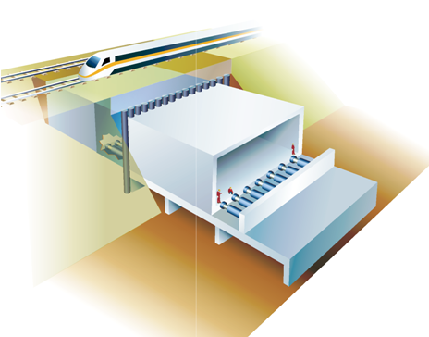
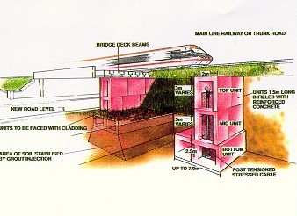
ESTABLISHED METHODS

Slide 4
JACKED DECK CONCEPT
A patented approach which builds on proven horizontal jacked installation techniques
Based on the installation of a slide path within access tunnels or boxes.
Deck units are jacked in along the slide path as excavation takes place in a compartmentalized shield fixed to the leading unit.

Slide 5
JACKED DECK BENEFITS
Continuous face support with full structural lining
Minimizes exposed soil face
Install greater spans and longer drive lengths
Close installation accuracy

Slide 6
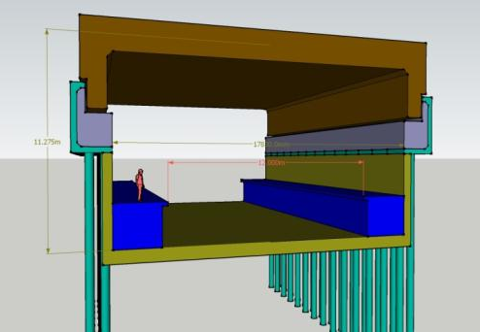
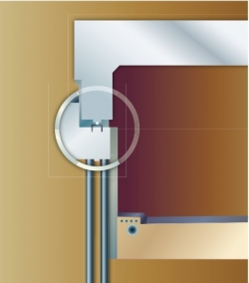
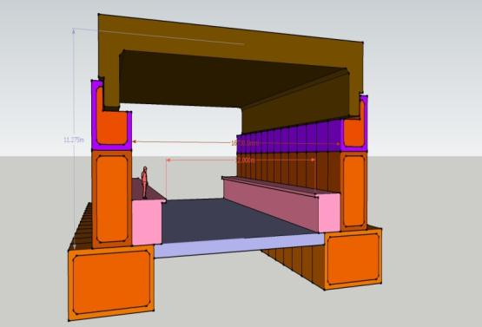
ALTERNATIVE ABUTMENTS
Jacked Access Box and piled abutments
Jacked foundation and wall boxes
Tunnel and
piled abutments

Slide 7
EAST KENT ACCESS PHASE 2
Client: Kent County Council
Engineer: Jacobs
Scheme prequalification in 2008 Bids submitted in March 2009
Original scheme concept for Cliffsend:
Twin Jacked Boxes
Contract Award:
VolkerFitzpatrick HOCHTIEF JV

Slide 8
EAST KENT ACCESS PHASE 2
The East Kent Access road involves:
8km dual 2 -lane carriageway with 3 roundabouts
An area of outstanding archaeological significance
Design and Construct Structures
2 span dual carriageway road bridge over railway
A 100m+ underpass under rail tracks and level crossing at Cliffsend
Client’s Perspective
Its not a road scheme
It's a railway crossing scheme with archaeology

Slide 9
SCHEME LAYOUT
A299
CLIFFSEND
A256

Slide 10
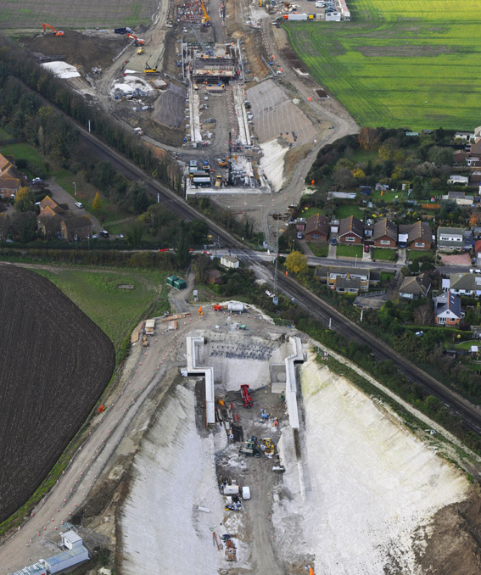
CLIFFSEND UNDERPASS
Looking West
Picture courtesy of VolkerFitzpatrick HOCHTIEF JV

Slide 11
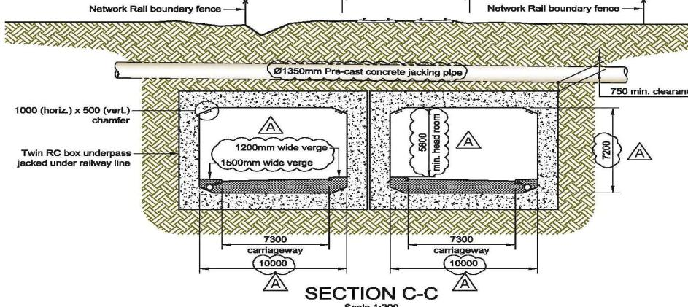
KCC/JACOBS TENDER SCHEME
Suggested installation concept based on box jacking
Two parallel boxes 10m wide x 7.2 m high
Total box length 2 x 103 metres, each in three sections
Cover below rail tracks 6m

Slide 12
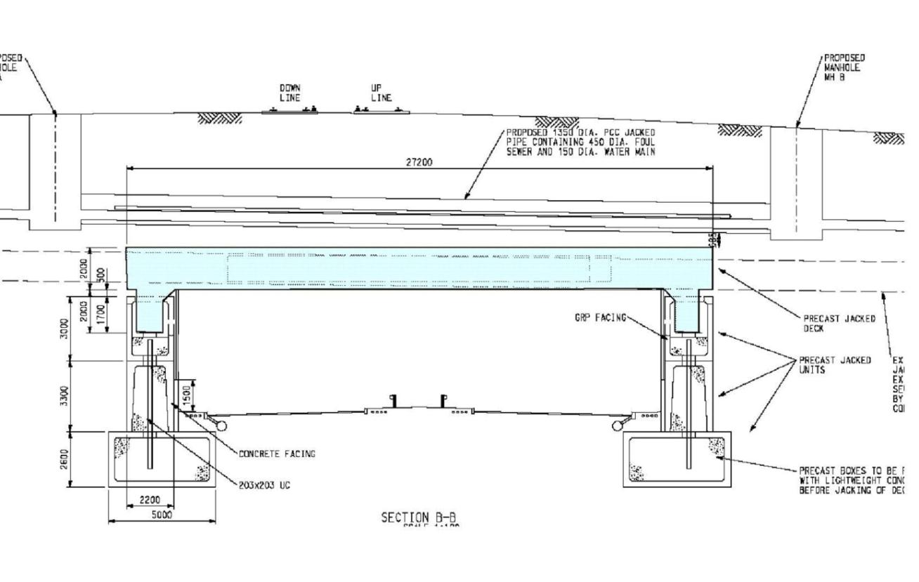
VolkerFitzpatrick HOCHTIEF JV Design and Construct Submission
Following Value Engineering

Slide 13
VolkerFitzpatrick HOCHTIEF JV CLIFFSEND TEAM
Permanent Works Designer Atkins
Deck Jacking Mammoet
Piling
Keller
Third Party Checker Tony Gee & Partners
Jacked Installation Consultant Jacked Structures
Tunnelling
Pilots - Murphy
Deck - McBurney
Precast Concrete
Sian Formwork (Deck)
F P McCann (Segments)
Main Contractor
VolkerFitzpatrick HOCHTIEF JV

Slide 14
GEOLOGY
Drift - Head Brickearth
Overlying Thanet Sands (1-2m thick)
Drift - Chalk Head
Overlying Chalk (1-2m thick)
Solid - Thanet Sand
Thickness increasing towards the south,
Solid- White Chalk
Underlying entire site

Slide 15
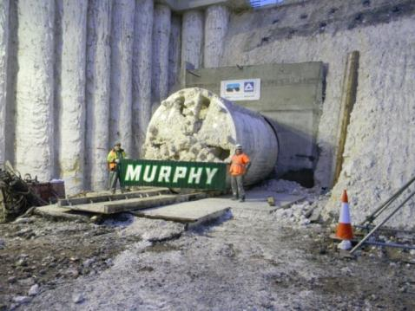
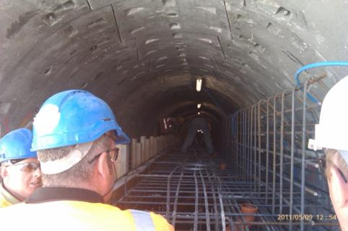
PILOT TUNNELS

Slide 16
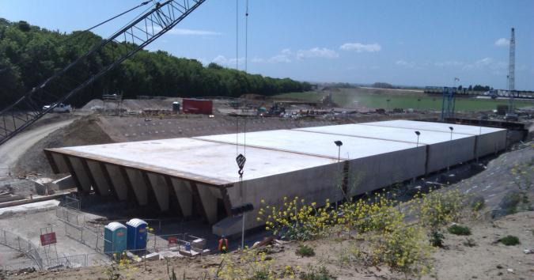
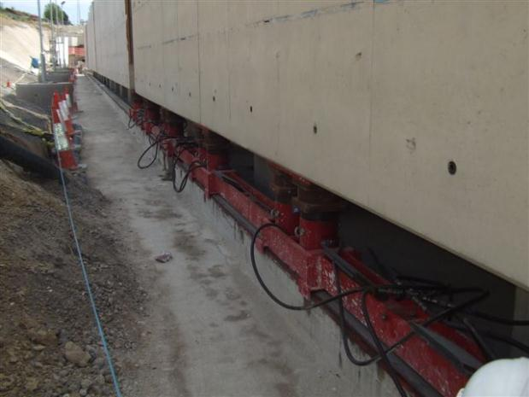
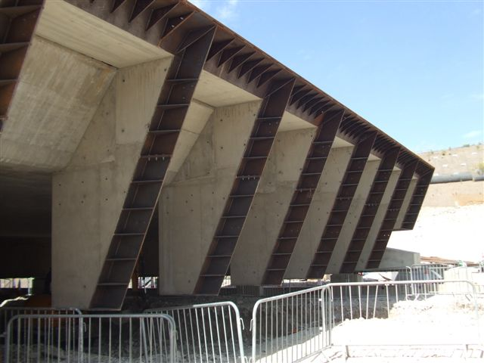
DECK / SHIELD

Slide 17
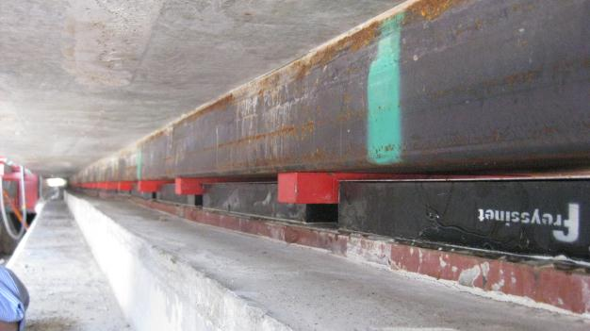
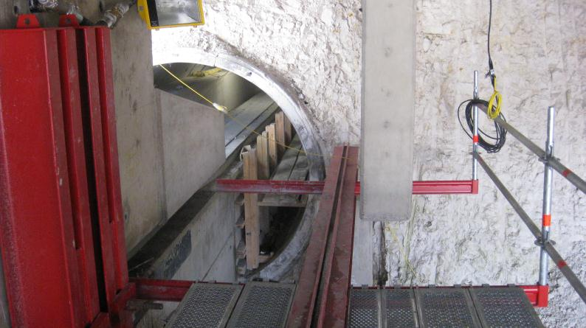
SLIDE TRACK

Slide 18
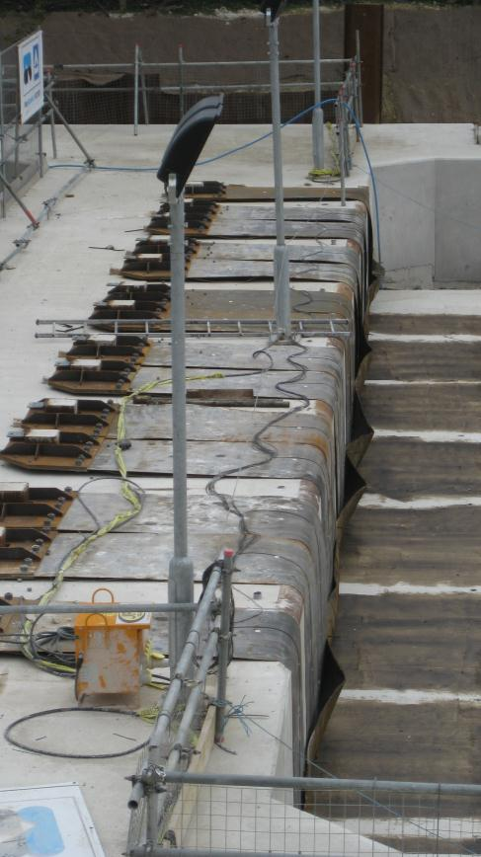
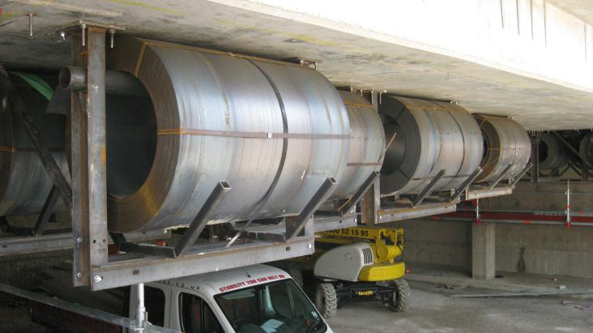
ANTI DRAG SYSTEM

Slide 19
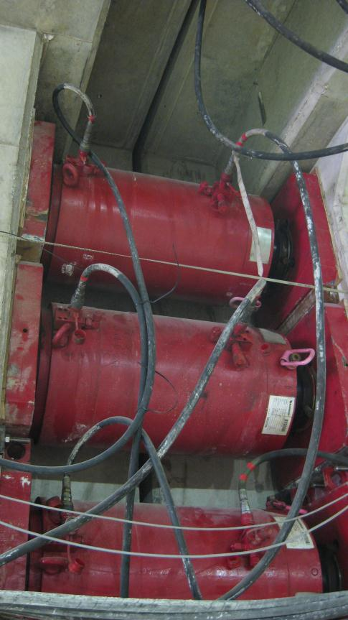
JACKING

Slide 20
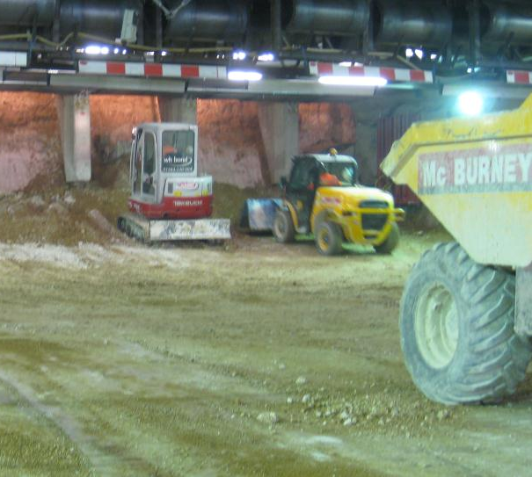
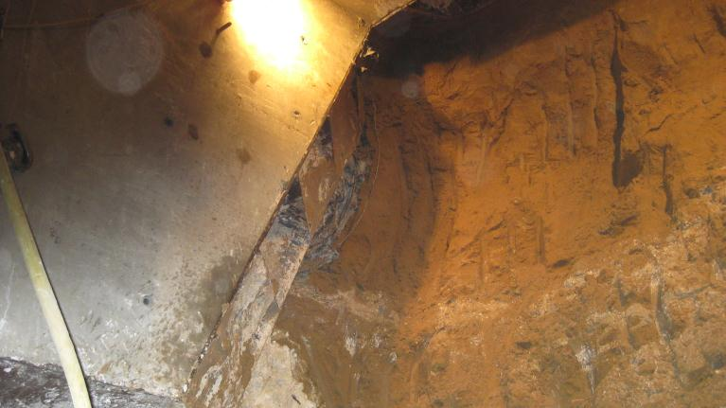
EXCAVATION
Average progress 2m / day

Slide 21
NETWORK RAIL INTERFACE
Continuous automatic monitoring
Track fettling during non revenue hours

Slide 22
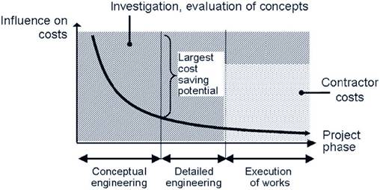
GOING FORWARD
Integrated structural solutions facilitate greater structural lengths and spans
A cost effective approach
Continuous structural ground support reduces risk
Applicable to Underpasses, Metro Stations and Launch Boxes
Early engagement is vital to realise full benefits

