Slide 1
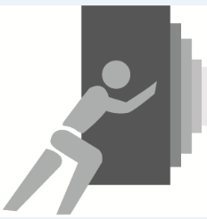
Innovation in Creating Large Underground Structures
James C Thomson CEng
Chairman
Chris Howe CEng
Senior Consultant
JACKED STRUCTURES SA PUSHING THE BOUNDARIES

Slide 2
Background and developmEnt
James C Thomson CEng
JACKED STRUCTURES SA PUSHING THE BOUNDARIES

Slide 3
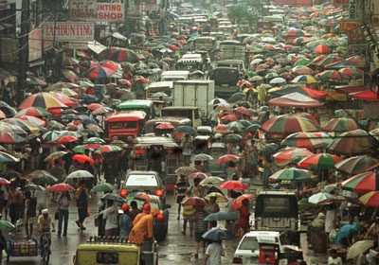
MIGRATION
TODAY MORE THAN 50% OF THE WORLDS
POPULATION
LIVE IN URBAN AREAS
BY 2070 THIS IS PREDICTED TO BE 70%

Slide 4
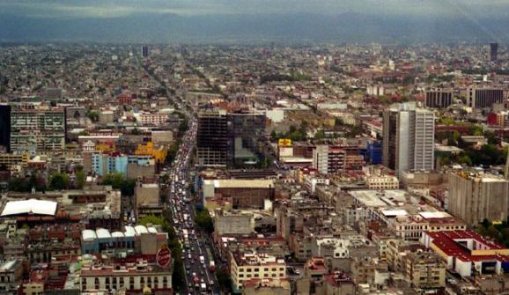
CONGESTION
SPACE IS AT A PREMIUM FOR PEOPLE
TRAFFIC , FACILITIES, STORAGE, LEISURE AND PUBLIC AREAS

Slide 5
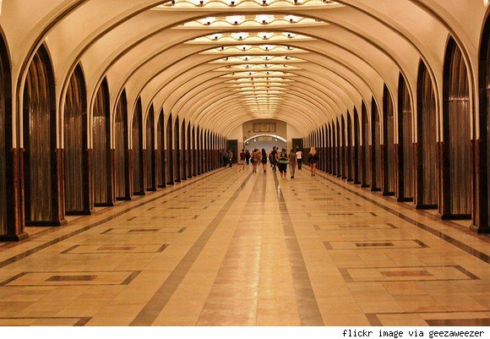
DEVELOPING UNDERGROUND
INCREASINGLY WE ARE MAKING USE OF THE
GROUND THAT LIES BELOW OUR CITIES

Slide 6
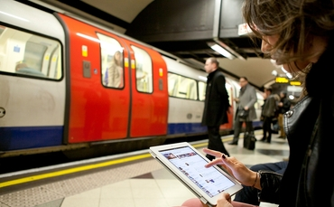
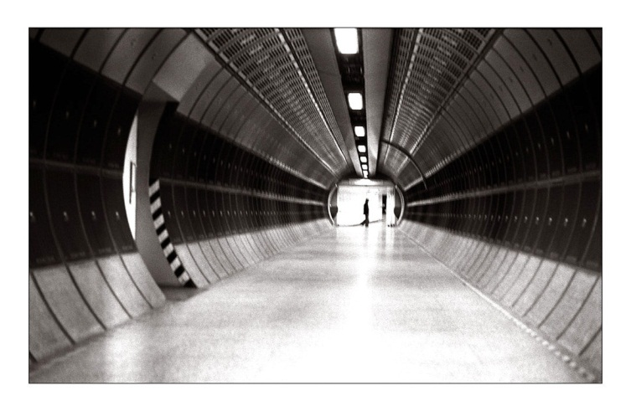
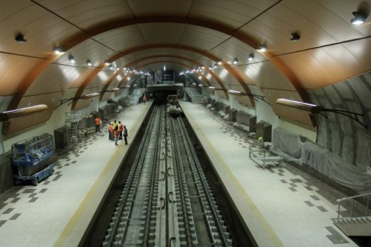
EXISTING DEVELOPMENTS
Many cities have or are installing Metros
to transport the people and
reduce vehicle use.
Many include shopping concourses.

Slide 7
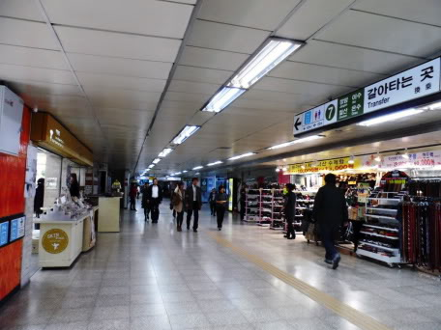
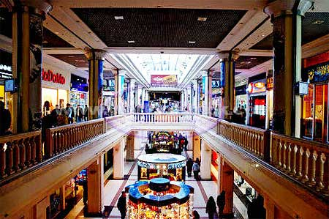
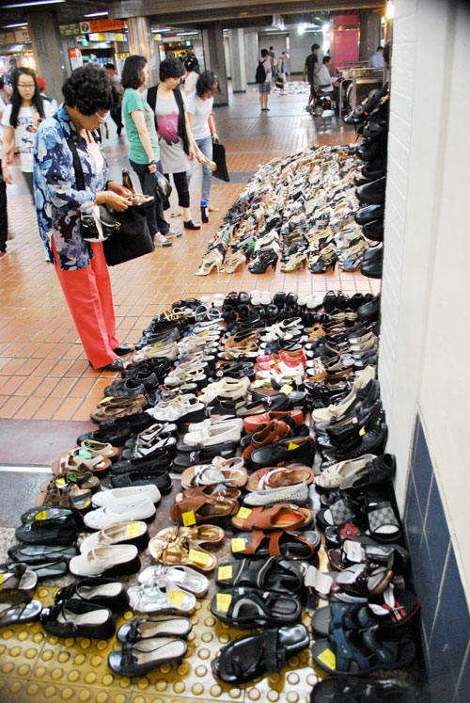
Developing Underground
Many cities have created interlinked pedestrian precincts and shopping facilities underground
allowing safe and comfortable conditions in all weather

Slide 8
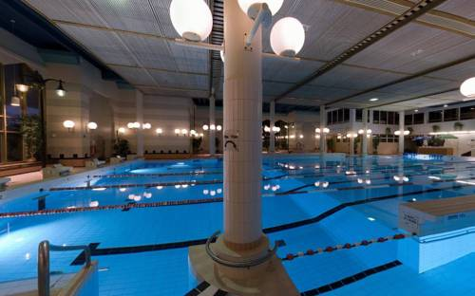
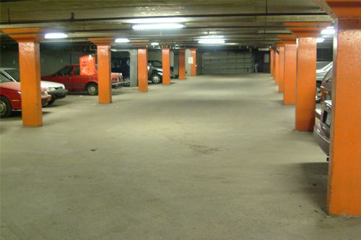
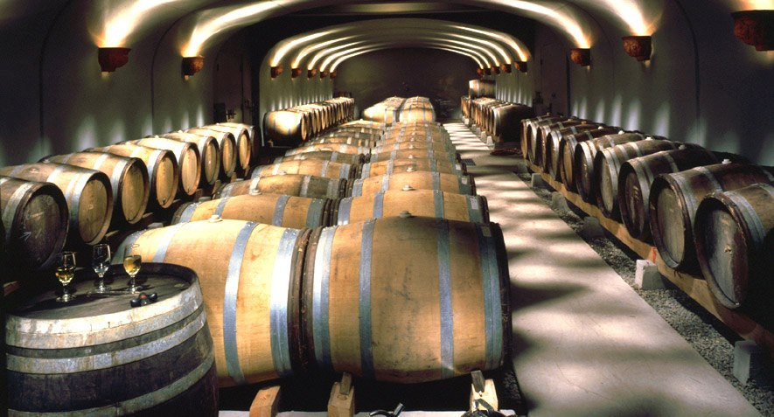
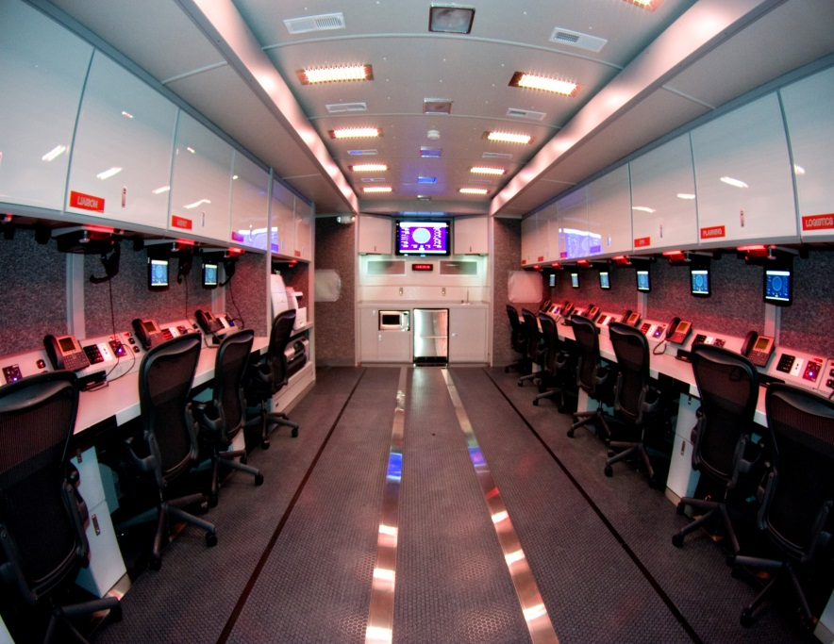
Developing Underground
Unlimited applications including
  sports facilities
  Parking
  Storage
  computer control rooms

Slide 9
Construction of Underground Facilities
Modern tunnelling techniques allow circular tunnels up to 15m diameter in all kinds of ground conditions and widely used for metro installations
Most examples of other forms of underground installations have been in competent rock
Top down construction requiring large excavation from the surface and subsequent reinstating which involves considerable surface disruption

Slide 10
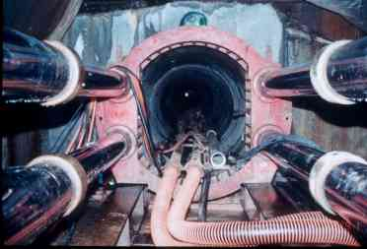
Jacked Horizontal Construction
The use of precast pipes and horizontal jacking has come to be an important method of tunnelling in the last 40 years

Slide 11
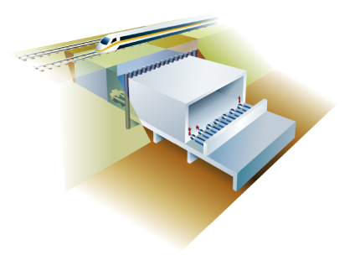
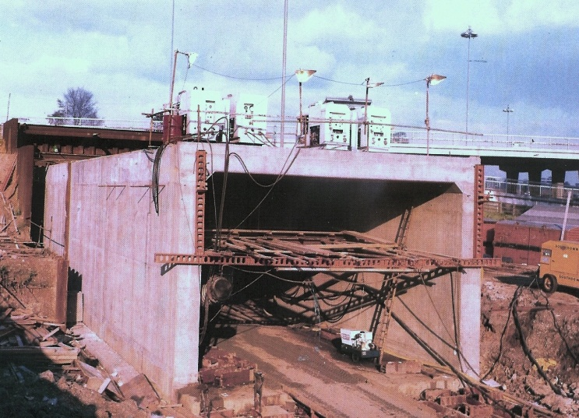
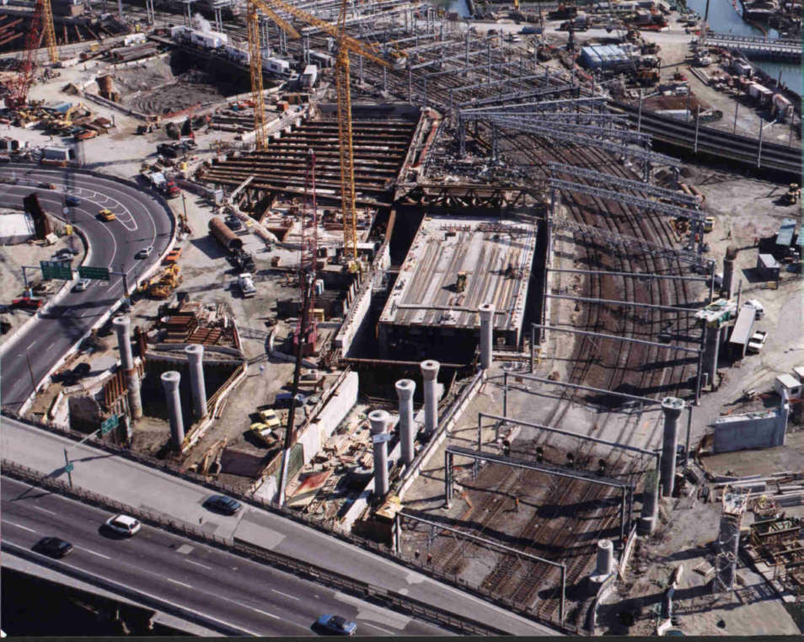
Jacked Horizontal Construction
BOX JACKING
Box cast on site with a shield then
jacked into position as excavation
proceeds
WITHOUT surface disruption
Brent Cross UK
Boston – Big Dig

Slide 12
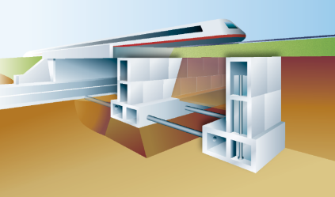
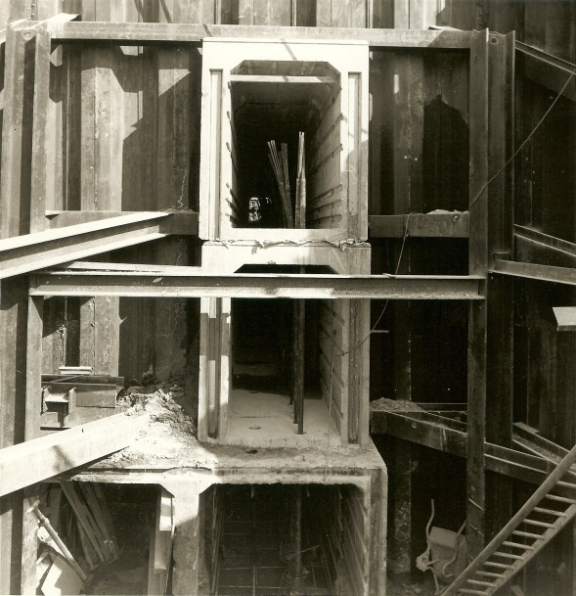
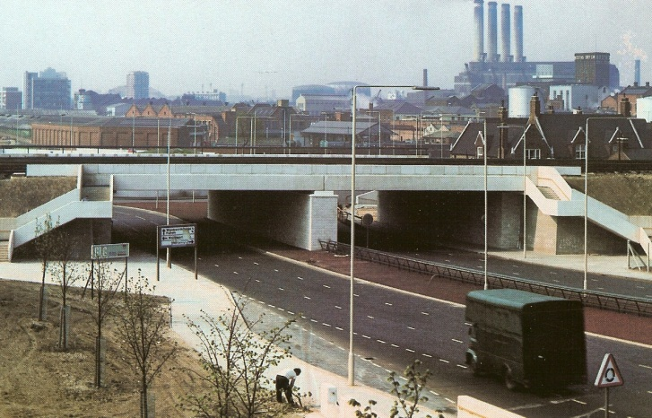
Jacked Horizontal Construction
MODULAR CONSTRUCTION
Jacking precast boxes
to install abutments
and central pier
deck placed in short possession.
Wandsworth - London
Underpass below rail tracks
Modular Abutment Boxes

Slide 13
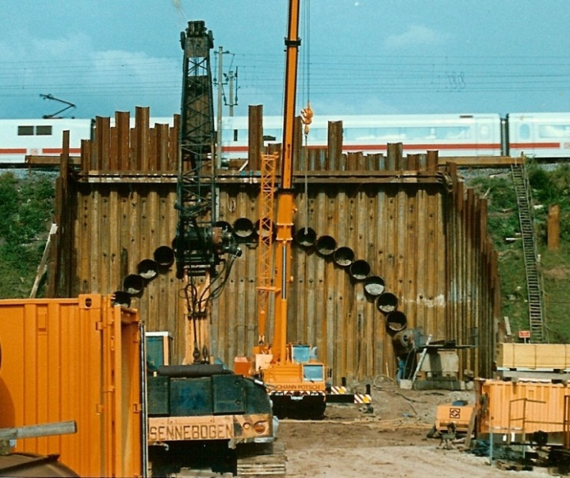
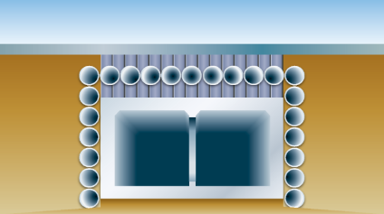
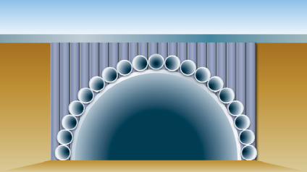
JACKED HORIZONTAL CONSTRUCTION
ADVANCED SUPPORT STRUCTURES
A support canopy
installed by horizontal boring or
micro tunnelling methods
Alternative Geometry

Slide 14
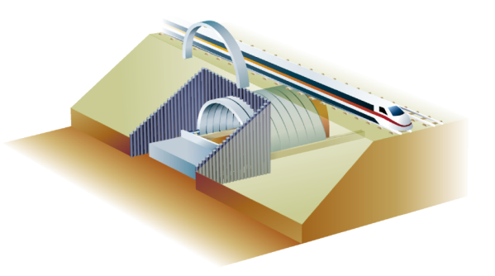
Recent Innovations
Jacked Arch
Jacked Deck
The concepts are based on:
Breaking down the installation into controlled components
Using high quality precast units
Combining tunnelling with deck/arch units jacked along a slide path
Providing a full structural lining at every stage
Notes:
These techniques support NR development of innovation
to deliver the investment programme
by reducing the number and
duration of disruptive possessions. avoiding
weekend engineering possession of 54
hours
resulting in less disruption
more services, particularly at weekends
and bank holidays
operation of the working timetable on a
more consistent basis, without routine
interruption, diversion or bus substitution
We can provide greater standardisation of
specifications and designs to reduce the
time and cost of developing plans and
the unit cost of producing components.
Innovative working techniques do not rely on
increased proportion
of activity undertaken to be in the summer to
maximise use of daylight working

Slide 15
Recent INNOVATION
Cliffsend underpass
Chris Howe CEng
JACKED STRUCTURES SA PUSHING THE BOUNDARIES
Notes:
Good morning to you all.
I will present highlights of a 4 year co-operation between Main Contractor: Volker Fitzpatrick HOCHTIEF Joint Venture and Jacked Structures SA during the development of the innovative solutions used to construct an extremely challenging new underpass beneath the existing main line railway without causing any disruption to services throughout the construction period.

Slide 16
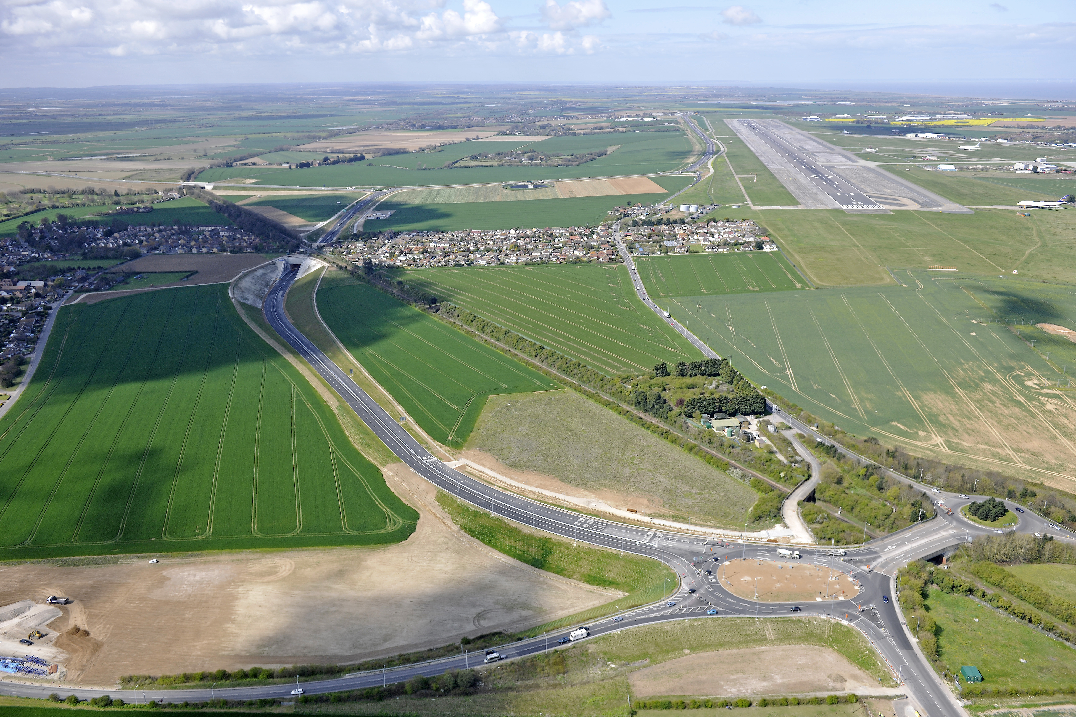
East Kent Access
Phase 2
Cliffsend
Underpass
126m longest Jacked Deck Structure below rail tracks
Client: East Kent CC
Contractor: Volker Fitzpatrick Hochtief JV
Picture courtesy of VolkerFitzpatrick HOCHTIEF JV
Notes:
To introduce this project I am starting with an aerial view of the completed Cliffsend section of the new highway.
Here you will see the underpass section through the village of Cliffsend, the railway intersection

Slide 17
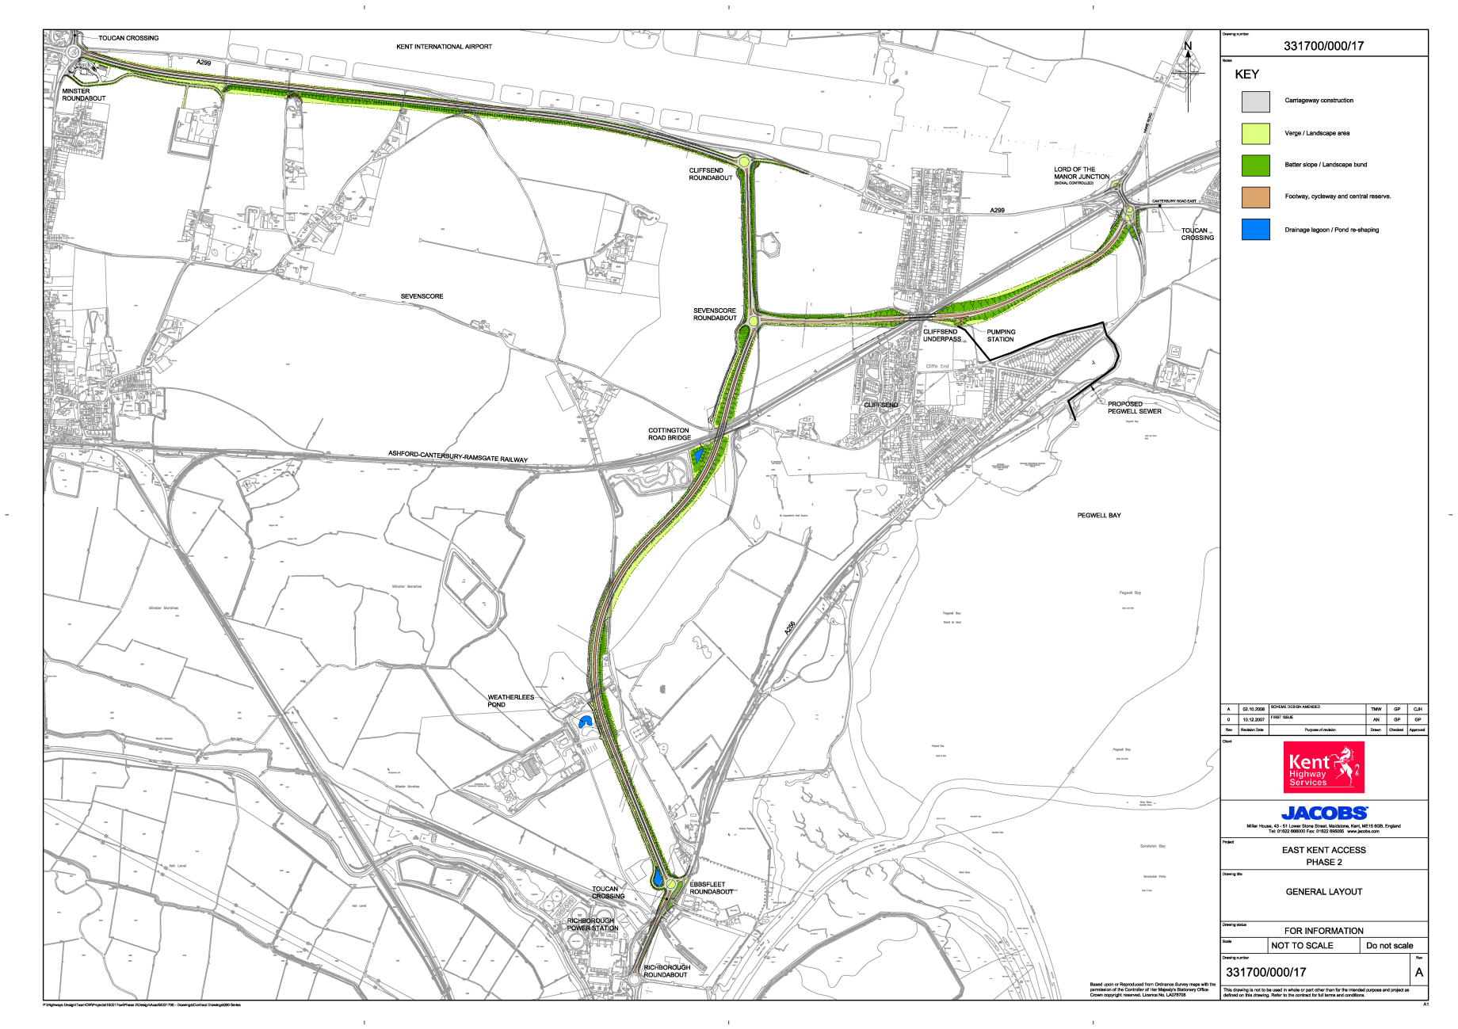
SCHEME LAYOUT
A299
Cliffsend
Underpass
A256
Notes:
The scheme provides 8km of dual carriageway and completes the A299 Thanet Way dualing that commenced in the late 1980’s
This final phase was completed ahead of schedule and within the £87m budget
Main Construction Contract awarded by the Highway Authority Kent County Council to a Joint Venture of VolkerFitzpatrick and Hochtief in August 2009.
Start of contract October 2009
Opened 23rd May 2012
Constraints in the area included the operational requirements of Kent International Airport, the built environment of Cliffsend and the internationally protected Pegwell Bay Area which severely restricted choice of route. The only route available was through the middle of Cliffsend beneath Foads Hill (detail) and the main London to Ashford railway lines .
This created the most challenging structure on the project
Cliffsend Underpass

Slide 18
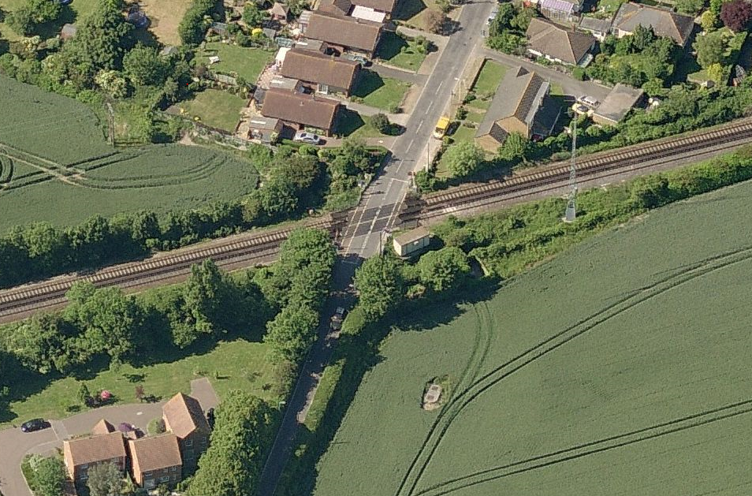
Cliffsend Site – looking North
route
Notes:
Aerial view looking north over Cliffsend Village, Foads Lane level crossing with the main line railway. The approximate route of the new highway is indicated which will be 15m below the railtracks.
Construction options for the railway intersection provided a formidable challenge being constrained with 6m overburden, heavily skewed and in close proximity with residential properties. Two large sewers, utilities cables, electricity sub-station, radio receiver mast and sensitive level crossing equipment had to be maintained.
Network Rail were commencing a new high speed Javelin service to the new link with St Pancras International Station in London and rail operations were not to be disrupted during the construction stages.

Slide 19
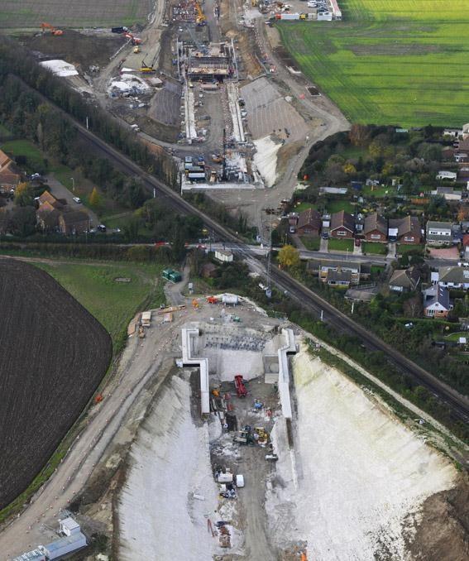
Cliffsend Aerial View
Looking West
Heavily skewed road alignment beneath rail
Nearby Residential Properties
Existing Foads Lane and Rail Crossing
Construction workyards each side of railway
Picture courtesy of VolkerFitzpatrick HOCHTIEF JV
Notes:
At Cliffsend the dual carriageway is within 15m deep cuttings either side of the railway .The Challenge was to develop a technique which minimises ground settlement

Slide 20
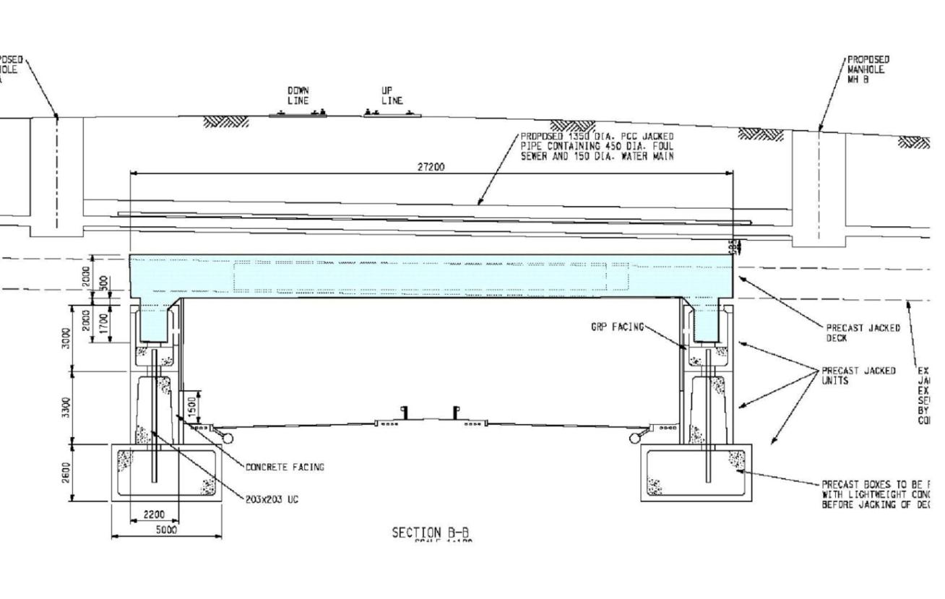
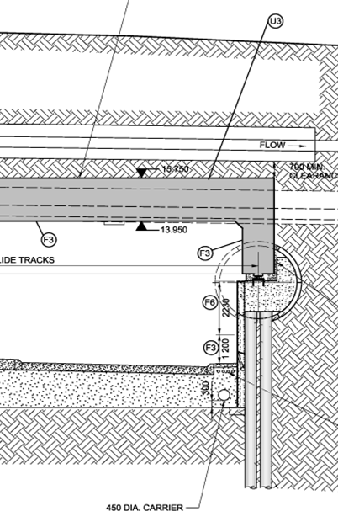
Design Alternatives
Value
Engineered
Notes:
The tender conforming design was based on a conventional pair of large jacked box sections
Concerns related to the jacking capacity required and control of alignment over such a length, also the height of open face excavation within the shields could lead to unacceptable settlement.
The team agreed a different approach was required due to the scale of the structure
and developed the tender submission utilising modular jacked boxes forming the abutments incorporating slide paths along which the main deck sections would be jacked into final position
Following the award of the contract the team carried out a number of technical reviews with value engineering and a final solution was presented and accepted by the Client.
The modular foundation units were replaced with twin 3.05m dia tunnels located 8.5m below the railway incorporating piles and pile caps supporting the slide paths for deck installation.
The piles would ultimately be exposed and faced to form the lower section of the abutment walls

Slide 21
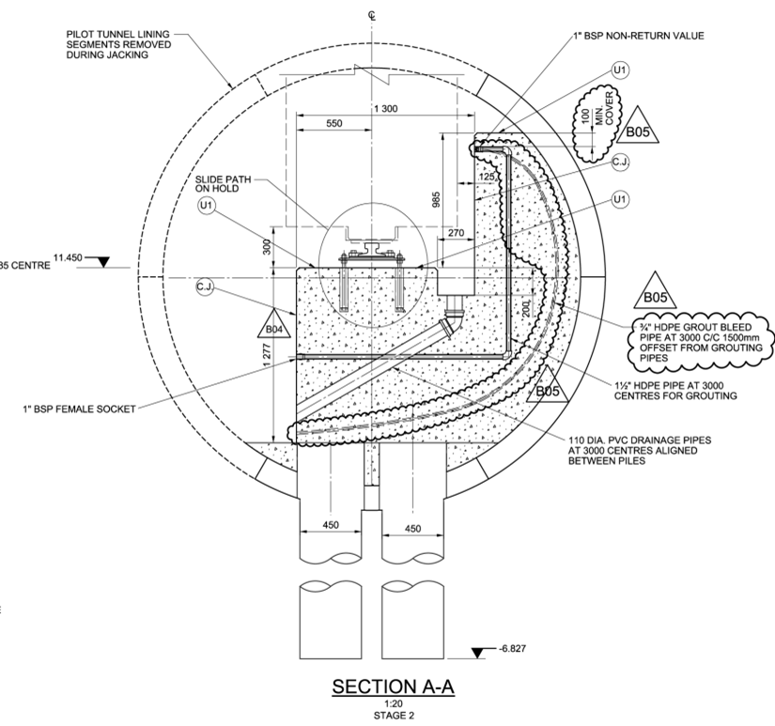
Bored Tunnels
Notes:
Design required construction of a pair of 3.5m dia tunnels bored 10m below the railway along the lines of the underpass walls. Piles were to be installed from within to complete the bridge abutments with connections to slide path foundations.

Slide 22
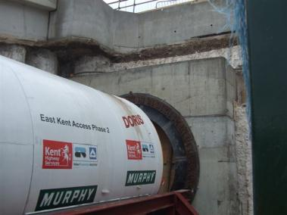
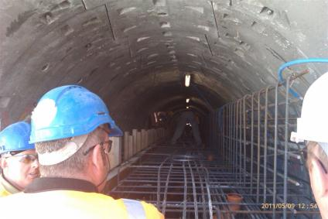
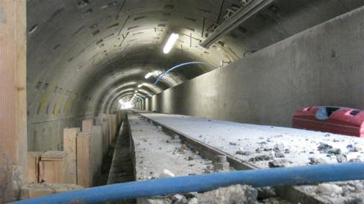
Bored Tunnel Foundations
Fig 1 EPB machine
Fig 2 rebar in foundations
Fig 3 Abutment concrete
Notes:
An Earth Pressure Balanced (EPB) tunnel boring machine was employed to drive the two 126m long tunnels with rail track movements continuously monitored from robotic Total Stations.Total vertical movement detected was 3mm. This was immediately followed with the installation of 530 no 450mm dia bored cast insitu piles 14m long with top 8m reinforced and completed in April 2011
RC pile caps were constructed within each tunnel with low friction slide paths set to high tolerances.
The design and quality of construction ensured the subsequent installation of the jacked deck would be accurately controlled.
The main slide track installed within the abutment tunnels incorporates a stainless steel sliding surface along which the jacked deck bearing slide. The system consists of 41mm thick elastomeric bearings with a bonded PTFE surface’ he total vertical load applied to the system is 50,000 tonne. Flexibility of 2mm is within the bearing and the slide track is installed to a tolerance of ±0.5mm
Tunnels were completed within an 8 week programme in December 2010

Slide 23
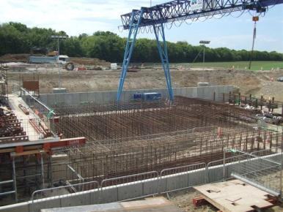
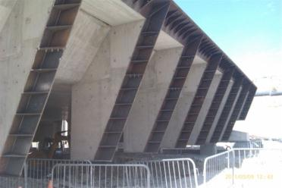
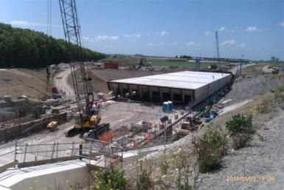
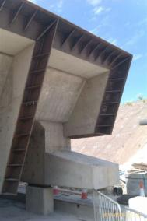
Deck Construction Stages
Fig 1 Precast yard
Fig 3 Shield Arrangement
Fig 4 Front of Deck Downstand
Fig 2 Pre Assembly Area
Notes:
The underpass roof comprise 6 abutting precast concrete units, each 23m wide, 22m long and 1.8m deep comprising heavily reinforced slabs with short downstands.
Between each abutting unit an Intermediate Jacking Station (IJS) is located with a steel skirt to support the overburden as the units open and close during installation
Each deck unit contains 1040m³ of concrete and 240 tonne rebar the high rebar density is required due to the loads from 6m overburden
The six massive deck and side wall elements were precast in turn at the rear of the construction workyard and consecutively moved up to the assembly area on temporary slide tracks.
The lead deck unit incorporates a mining shield and cutting plates designed to provide intimate support and contact with the open face excavation. 8 cells provide working space for excavation plant and miners
The compartmentalise cutting shield was added to the lead unit at this stage. Cantilevered leading sections with sledges were added to the deck walls to carry the overburden load above the shield. The geometry was detailed to allow entry into the pre-installled bored tunnels and allowing clearance for partial removal of tunnel segments as the deck advanced.

Slide 24

Cliffsend Jacked Deck
Jacked Deck Pre-Assembly Area

Slide 25
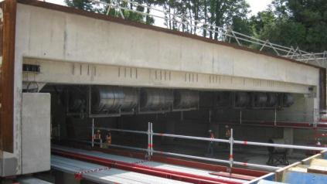
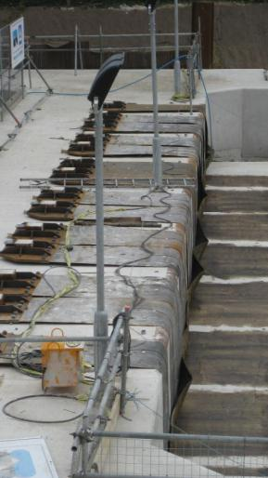
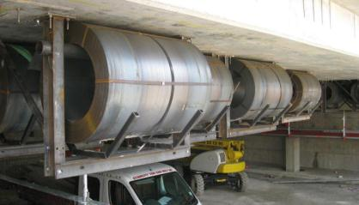
Anti Drag System
Fig 1 lead unit front IJS
Fig 2 ADS storage coils
Fig 3 ADS headwall anchor
Notes:
Initial use of box jacking techniques installed with shallow cover below rail facilities saw horizontal movement of the soil mass and rail trackbed during the installation process. For this reason it has been common practice when undertaking box jacking works to introduce an anti drag system between the top surface of the jacked box and the overlying soil.
At Cliffs End the general depth of overburden, some 6m below the rail track bed, is such that large scale lateral movement of the ground was considered a very low risk, the shear resistance at the sides of the ground block above the proposed deck offering ample resistance against wholesale lateral movement.
Lateral movement of soil at the interface between the deck and the overlying ground could occur due to frictional forces. Such gound migration as the deck is installed ccould be expected to contribute to settlement at the west side of the installation and potential heave at the east side.
For this reason an anti drag system focussed upon the need to mitigate ground migration due to frictional forces along the length of the deck was installed, removing the risk of any associated settlement or heave during installation.
The sheets are stored in rolls in the roof of the front unit,fed out through slots in the shield and anchored to the headwall beam in the launch pit. These remain stationary at the soil interface and together with lubrication allow easy movement of the concrete deck units at this interface. Lubrication is bentonite or high viscosity gels through grout manifolds along each deck unit.

Slide 26
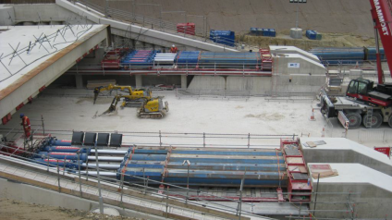
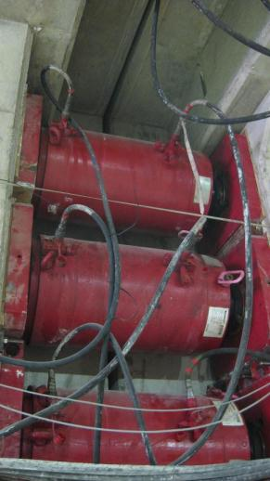
Deck Jack Assemblies
Fig 1 Rear Jack Station – 7000tonne
Fig 3 Accumulated Jacking Resistance
Fig 2 Inter Jacks – 7000tonne
Notes:
The jacking process is 24/7 with about 2.5 day turn around for locating subsequent deck units. Total installation covered a period of 10 weeks

Slide 27
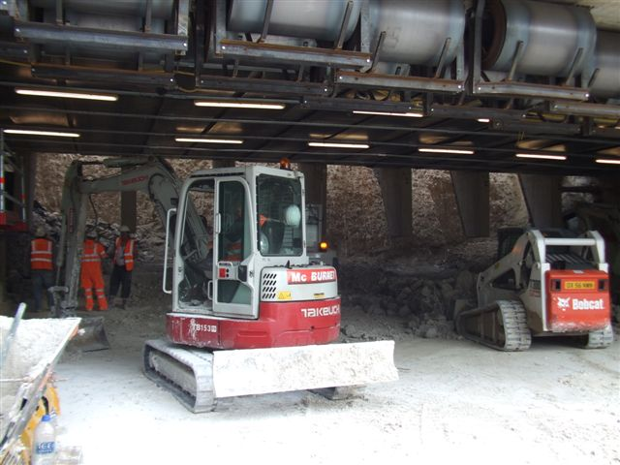
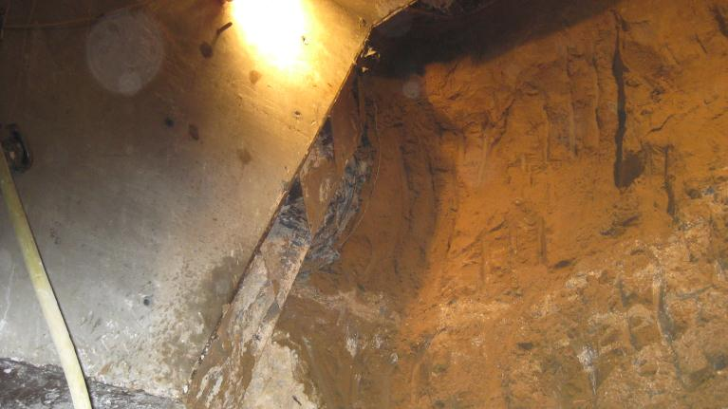
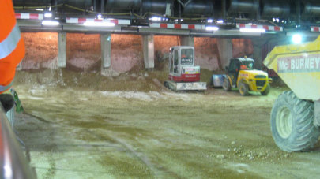
Shield Excavation
Fig 1 Start of shield advancement
Fig 2 top corner of shield embedded
Fig 3 Shield fully penetrated ground

Slide 28
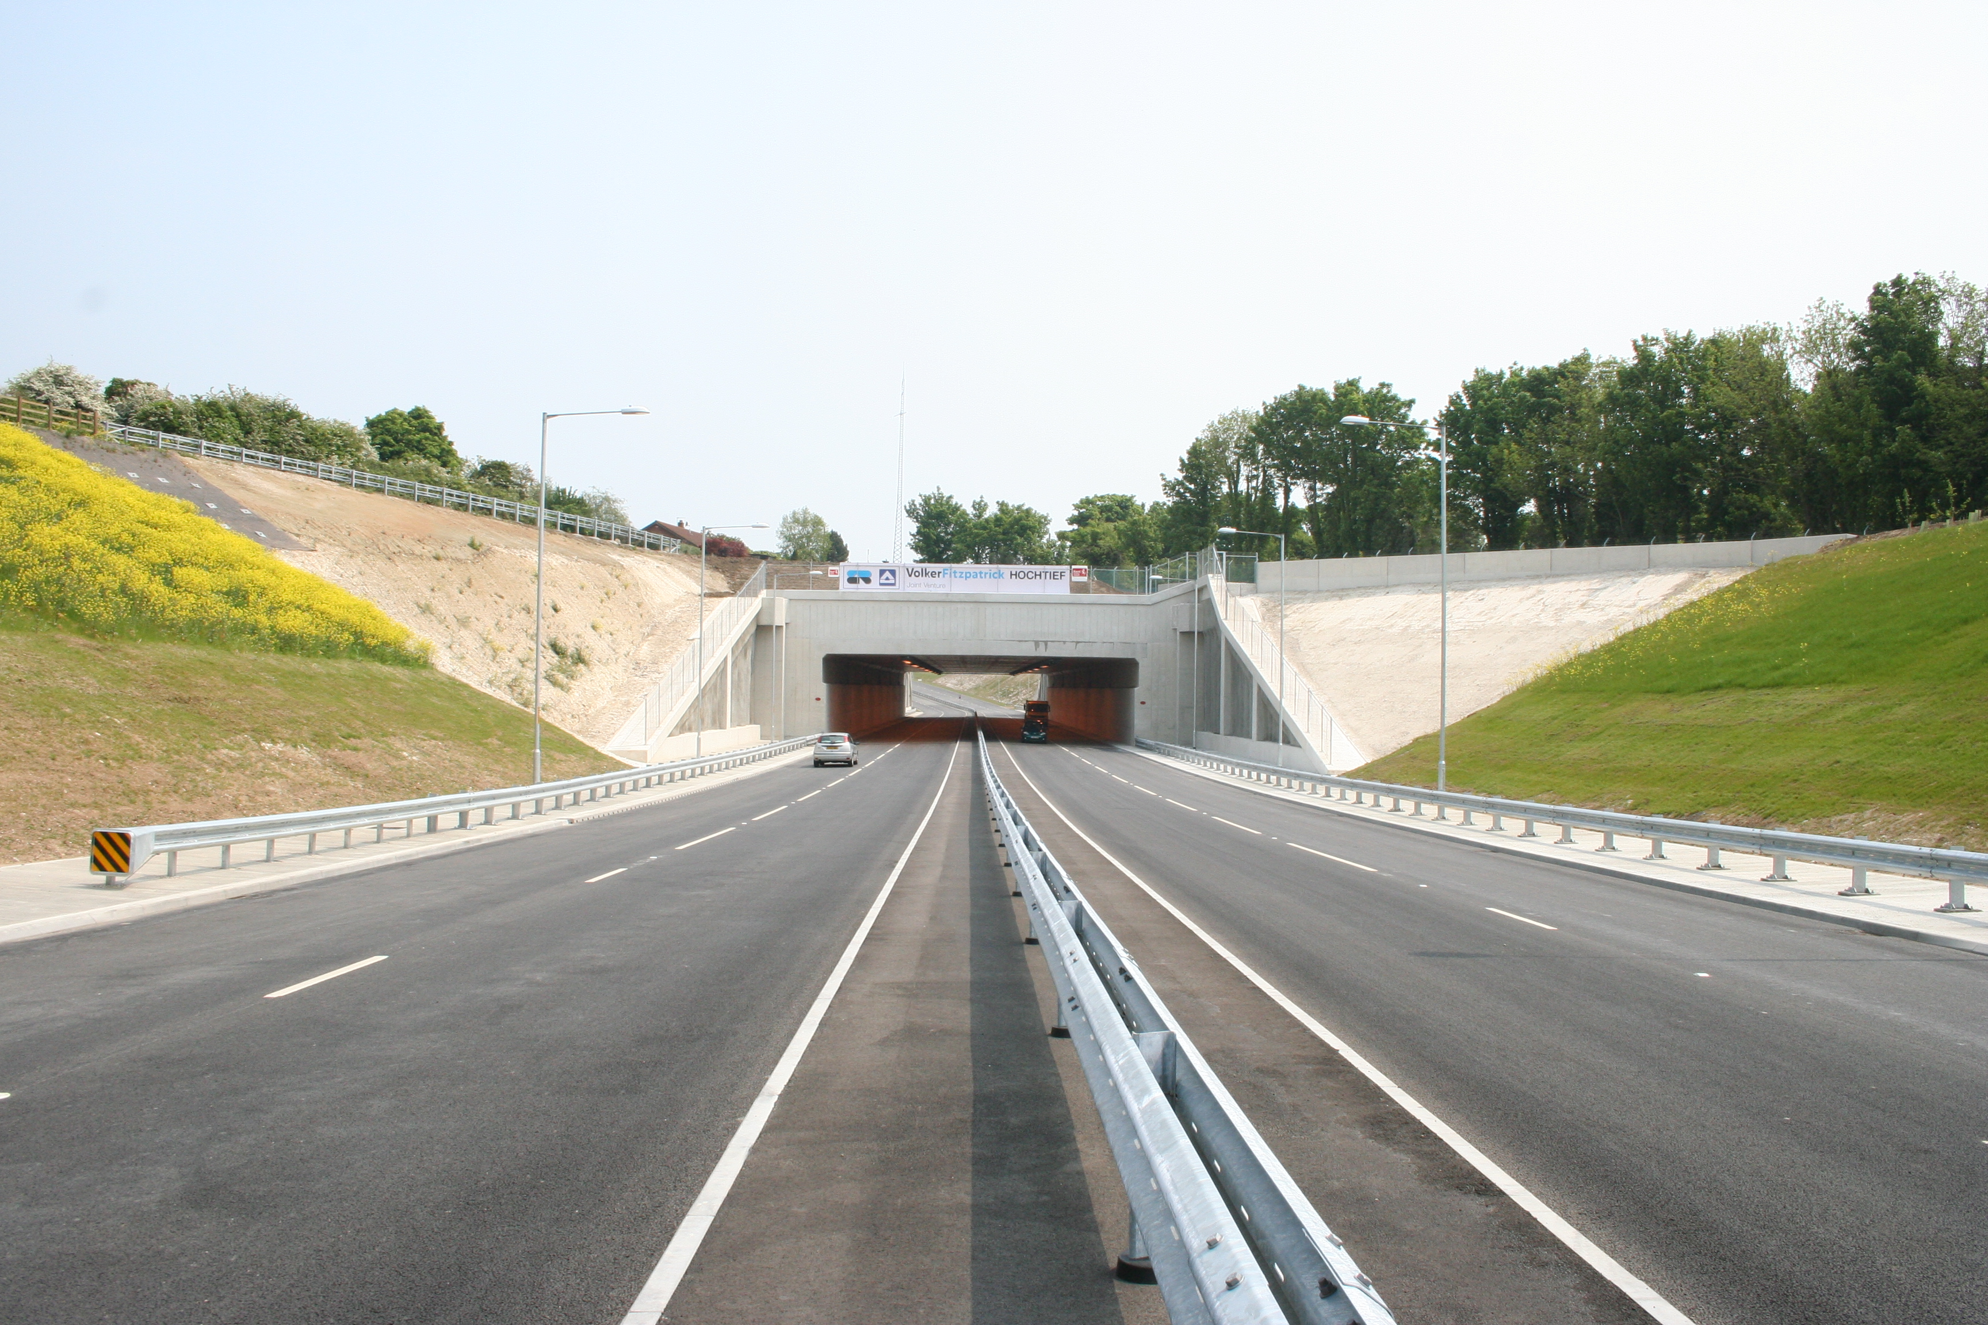
Opened
23rd May 2012
Picture courtesy of VolkerFitzpatrick HOCHTIEF JV

Slide 29
Advantages of the JACKED ARCH AND JACKED DECK CONCEPTS
Designed to work all types of soil
A full structural lining at all stages of excavation
Reduced exposed excavation faces
Guaranteed accuracy of installation
Minimal surface settlement
Much larger and longer structures
Reduced time of installation under critical surface facilities

Slide 30
Opportunities for Creating Underground Space
A whole range of larger and l o n g e r underground installations are now possible in a wide rang of configurations
When the Client requires
Minimum Surface Disruption

Slide 31
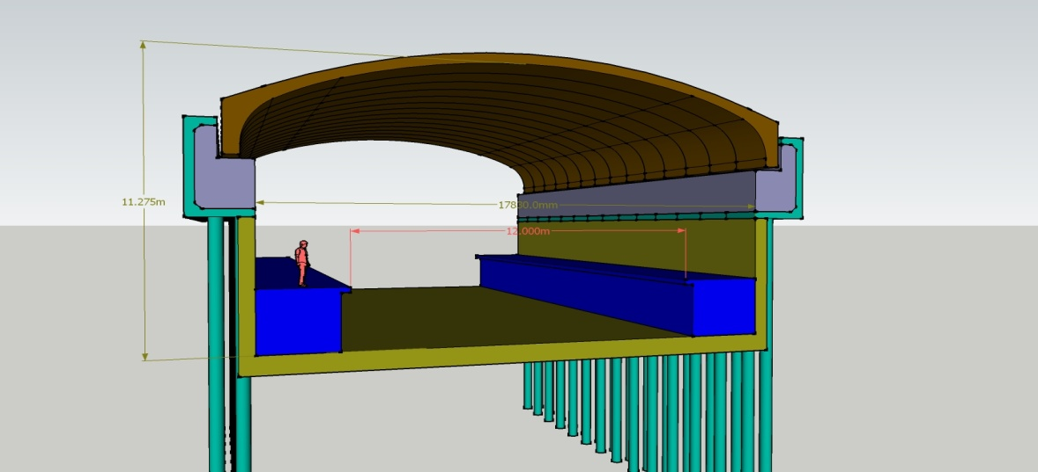
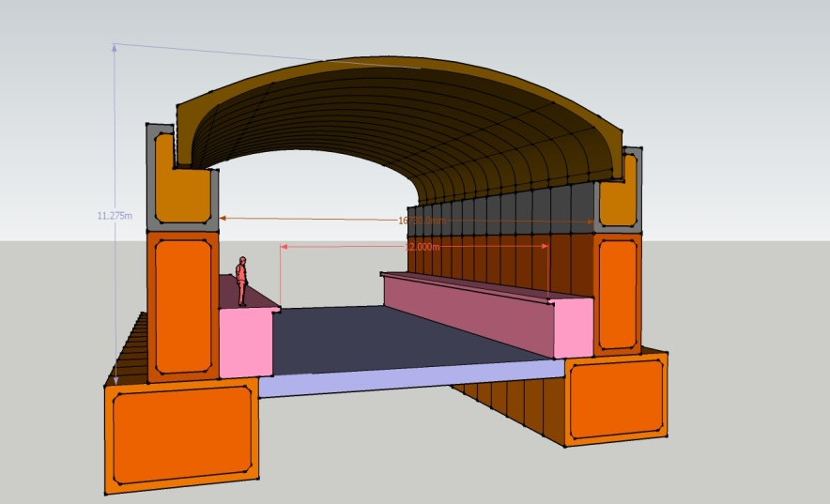
Metro Stations-
Arch Configurations
Jacked Top Box and Piles
Jacked Modular Abutment Boxes

Slide 32

Four Platform Arrangement

Slide 33


Metro Stations
Arch Configurations
Foundation box
Foundation tunnel

Slide 34


METRO STATIONS
Jacked Deck Concepts
Jacked Top Box and Piles
Jacked Modular Abutment Boxes

Slide 35

Underground station – piled abutments from a high level box and a jacked arch

Slide 36
Facilities that can be installed underground
Shopping arcades
Underground car parking
Leisure Facilities- swimming pools, gymnasiums etc
Storage and reservoirs
Wastewater and water treatment plants
Refuse collection and disposal depots
Military facilities
JACKED STRUCTURES SA PUSHING THE BOUNDARIES

Slide 37
Q & A
JACKED STRUCTURES SA PUSHING THE BOUNDARIES

